Slide 1
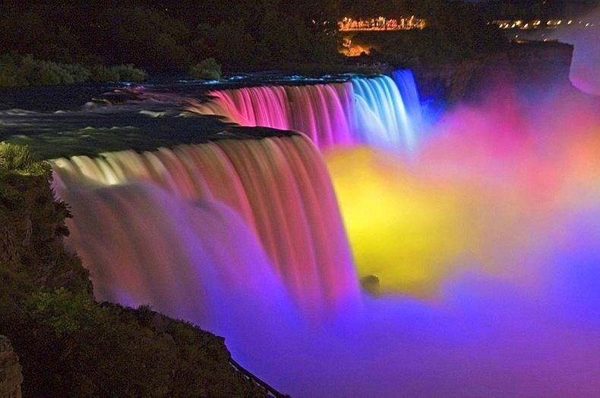
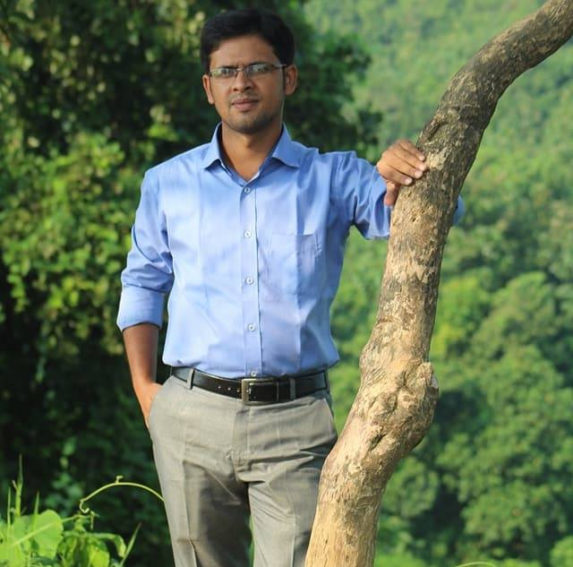
Identity
Rony Chakraborty
Assistant Teacher (English)
South Shilok M Shah Alam Chowdhury High School
Rajapara, Shilok, Rangunia
Presentation made for
class VI,VII,VIII

Slide 2





Slide 3

Learning outcomes
At the end of the lesson, we will be able to--
fill in the blank with the right form of verbs
Notes:
The main focus of this item will be achieved from this content.

Slide 4
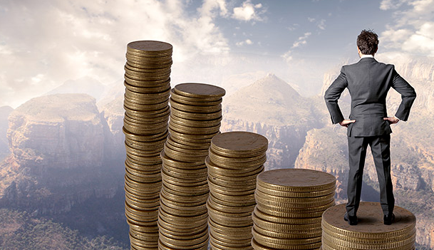
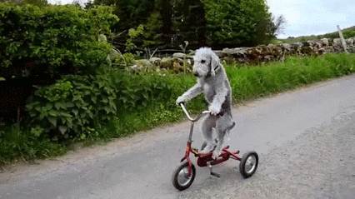
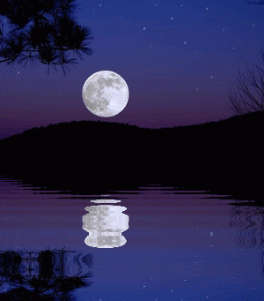
Health is wealth.
Practice makes perfect.
The moon shines
at night.
To mean universal truth or habitual fact,
will always be present indefinite tense.
Notes:
Rule of right form of verb in universal truth shown here.

Slide 5
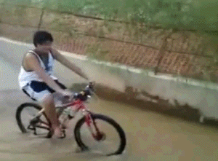
He not know how to ride a bicycle.
He does not know how to ride a bicycle.
If there is no be verb, do not/does/did not is used to make
a negative sentence according to subject and tense.
Notes:
Use of negative in action verb shown here.

Slide 6

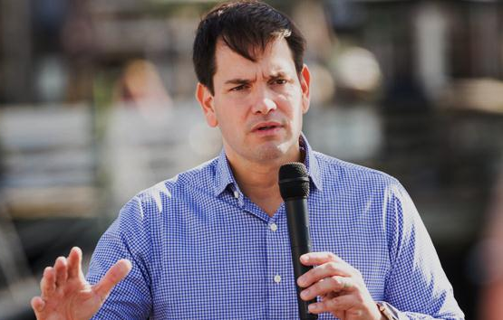
Do you want to say something to me?
Did you perform your own duty properly?
To make a ‘yes/no ‘question with action verb ‘do/does/did ‘is used before subject.
If negative, ‘don’t/doesn’t/didn’t’ is used like the same.
Notes:
Use of negative in ‘Yes/No’ question shown here.

Slide 7
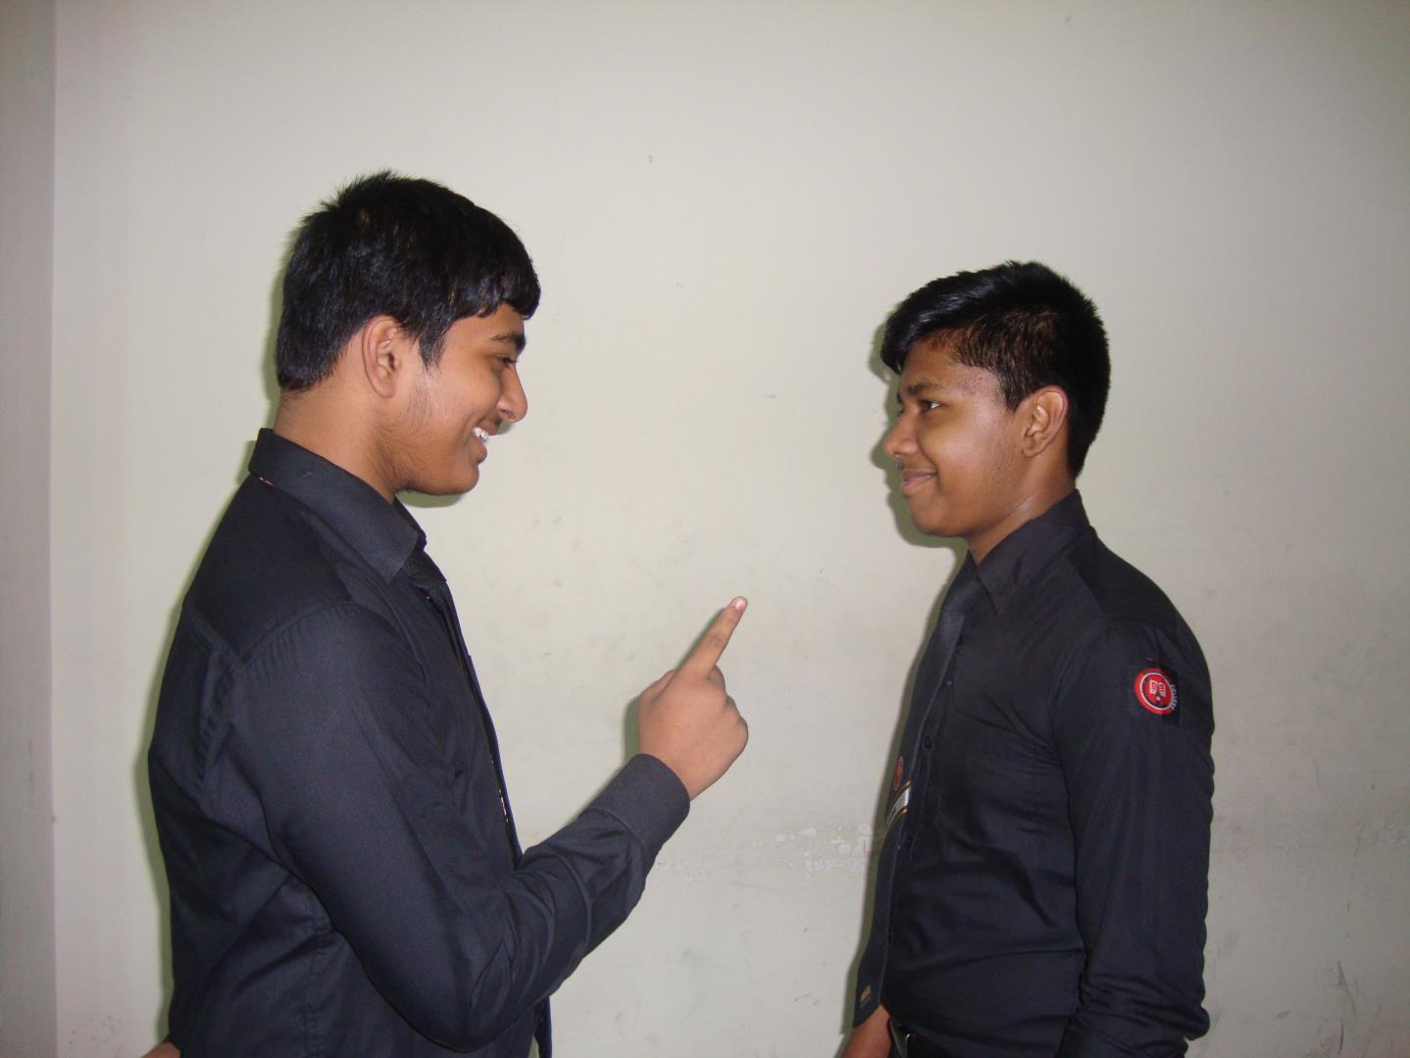
What do you like?
To make a ‘Wh ‘question with action verb ‘do/does/did ‘is used before subject and after ‘Wh’ word. If negative, ‘don’t/doesn’t/didn’t’ is used like the same.
Notes:
‘Wh’ word means question word (What, Which, When, While, Where, Why, Who, Whom, Whose, How). Use of negative in ‘Wh’ question shown here.

Slide 8

If there is always, regularly, sometimes, often, generally, daily, everyday, normally
and such type adverb in a sentence, it will be a present indefinite tense.
A good student prepares his lesson regularly. He never wastes his time.
He maintains his daily routine punctually. He always follows his teachers.
Notes:
Use of right form of verb in habitual fact shown here.

Slide 9

Activities
Fill in blank with the right form of verb from the box below.
maintain | go | get up | read | take
play | visit | walk | say | make
Rahim is a good student. Normally he (a) ________ at 6 am. He (b) ________ his morning prayer regularly. Very often he (c) ________ out to enjoy the fresh air by the side of the river. Sometimes he (d) ________ on the grass. Usually he (e) ________ his lesson in the morning. Generally he (f) ________ his bath at 8 am. He (g) ________ the newspaper daily. In every afternoon he (h) ________ with his friends in the field. Occasionally he (i) ________ his relatives. He always (j) ________ his daily routine.
Notes:
Feed back of previous slides.

Slide 10


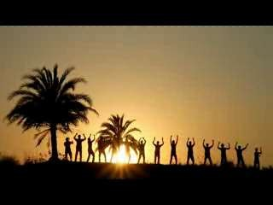
Thank you

Slide 11
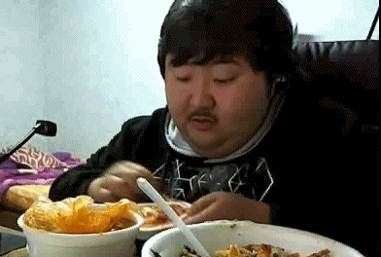
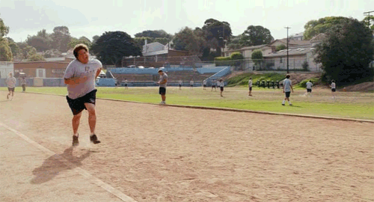
By this time I have finished 30 kilograms of breakfast.
He has completed 5 miles at a stretch.
V₃
V₃ (Verb past participle) is used after have & has in present tense.
Notes:
Use of past participle in present perfect tense shown here.

Slide 12
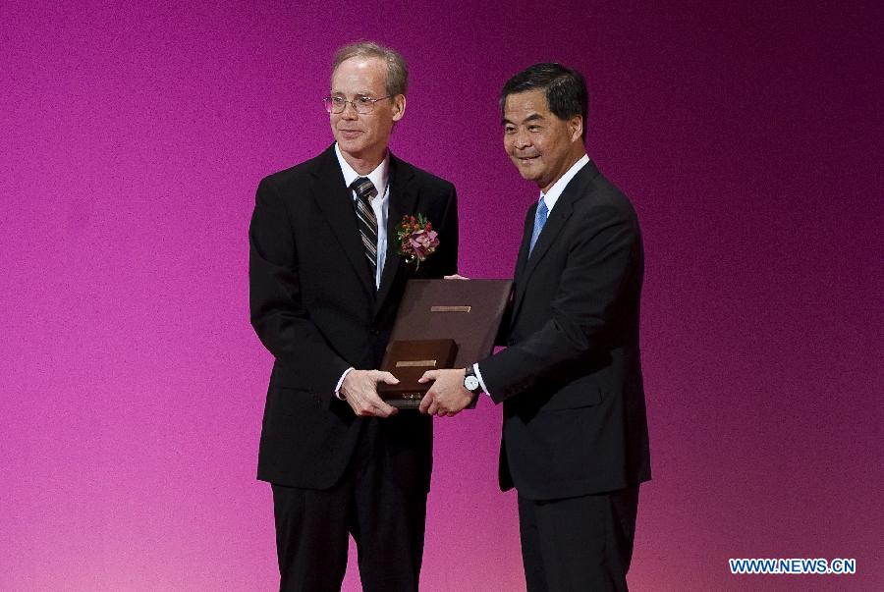
He did a good job and
he had got the award.
Remember,
You have to use ‘had’ after a past indefinite tense.
V₃ (Verb past participle) is used after had in past perfect tense.
Notes:
Use of past participle in past perfect tense shown here.

Slide 13
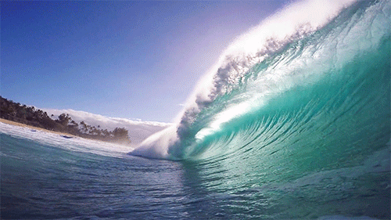
If there is just, already, recently, yet, ever, lately
in a sentence, it will be a present perfect tense.
Fill in the blank with have, has and had with V₃ of the following
verbs in the box below. You may have to use a verb more than once.
represent | enjoy | see | visit
“Have you ever (a)________ the wave of the sea?” “No, I (b) ________ never seen the wave but my brother (c) ________ many waves. Already I (d) ________ the spring. I told you that I (e) ________ a waterfall last year which (f) ________ a nice view.
Answer: (a) seen, (b) have, (c) has visited, (d)
have seen (e) had enjoyed (f) had represented
Notes:
Feed back on present and past perfect tenses.

Slide 14
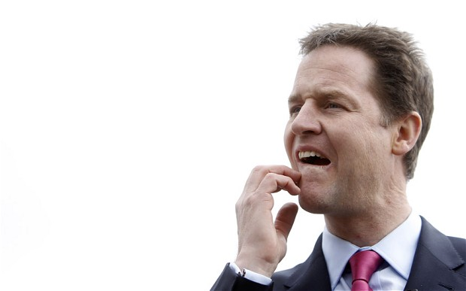
Don’t feel tension. Let me think a bit.
Imperative sentence never takes any
tense without present indefinite tense.
Notes:
Exceptional use of present indefinite tense.

Slide 15

Fill in the blank with right form of verbs of your own.
(a)______ up from sleep early in the morning and (b) ______ your morning prayer. Then (c) ______ a walk in the fresh air for a while. (d) ______ back home and (e)______ a light breakfast. (f)______ to your reading room to complete your home work. (g) ______ your teachers. Don’t (h) ______ with your friends. Let them (i) ______ by you. Never (j) ______ ill of others.
Notes:
Feed back on the right form of verb in imperative sentence.

Slide 16

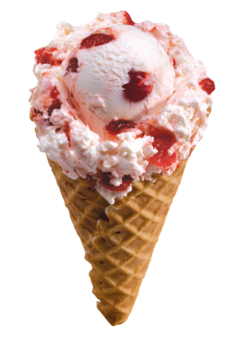
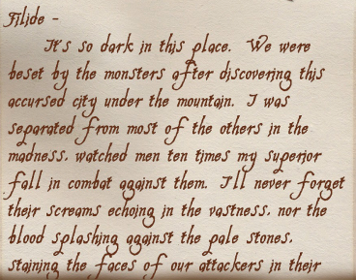
I saw a bird flying in the sky.
No one should like to eat an ice-cream.
He got me written the letter.
If there are two verbs in a simple sentence, next one is changed by
adding ‘ing’ writing ‘to’ before the verb or making it a past participle.
Notes:
Main theme is mentioned in the below part of the slide.

Slide 17
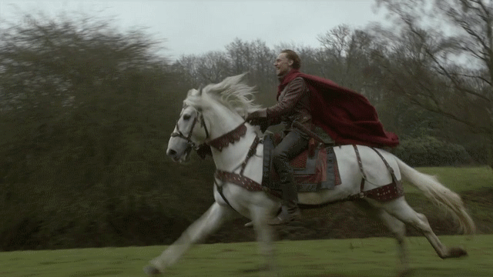
Fill in the blank with the right form of verbs given in the box.
dress | pass | ride | enjoy | run
We see the horse (a)_______. The man likes to (b) ________ the horse. He made the horse well (c) _______. Everyone likes to (d) ______ horse race. People used horse (e) _____ a long distance in ancient times.
Check your answer
(a) running, (b) ride, (c) dressed, (d) enjoy, (e) passing
Notes:
Feedback of above slide.

Slide 18
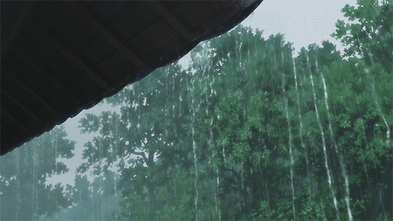

It has been raining
for two hours.
It had been raining
for last two hours.
Present perfect continuous tense
Past perfect continuous tense
‘last’ mentioning past. So this is past perfect continuous tense
If there is for/since long time/ two hours/three hours/four days/ five days
/a week and like this mentioning a series of time in a sentence, it would
be present/past perfect continuous tense according to the context.
Notes:
Difference between present perfect continuous and past perfect continuous tenses have been made clear with this slide.

Slide 19
Thank you

